Slide 1

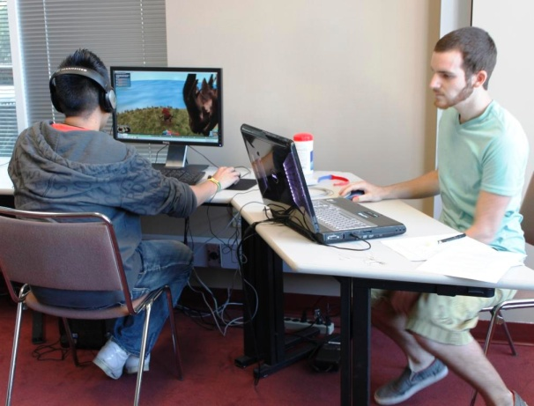
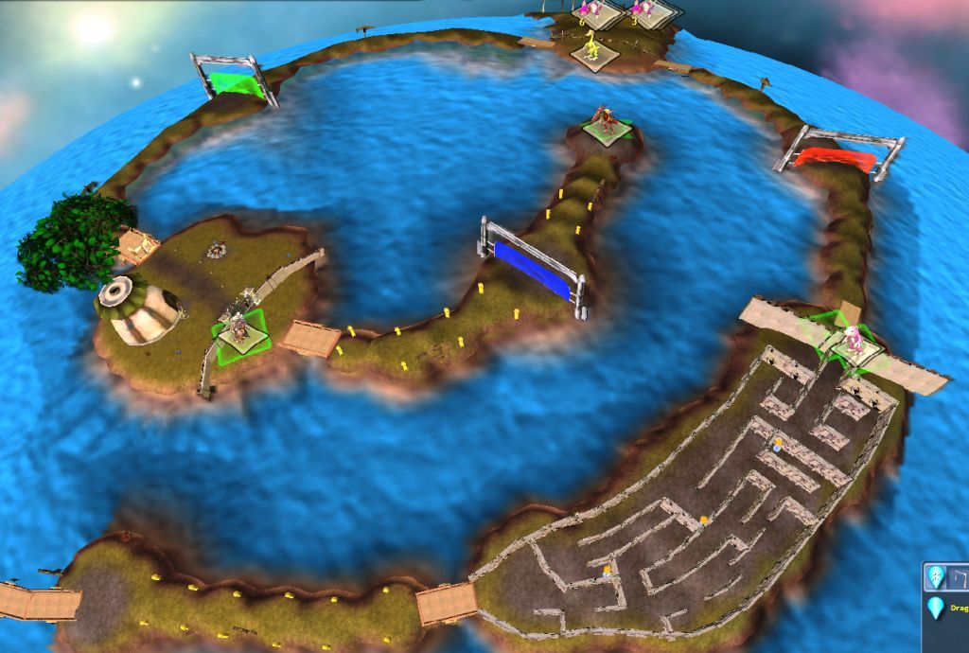
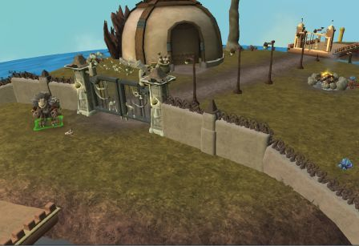
Narrative in Video Games: Investigating the Effects on Learning and Engagement
Veronica Vega
Robb Lindgren
Rudy McDaniel
University of Central Florida
October 13th, 2011

Slide 2

Studies on Immersion in Games & Effects on Learning:
Driving Questions
How do successful commercial games create psychologically immersive experiences?
How do the immersive properties of a game affect a player’s ability to learn within the game?
Can these properties be used to achieve specific educational goals?

Slide 3





An Anecdote

Slide 4
Research Foundations
“It is very likely the case that the most natural and the earliest way in which we organize our experience and our knowledge is in terms of the narrative form.” Jerome Bruner, The Culture of Education, p. 121
Previous research has found connections between the presence of narrative and learning outcomes in interactive digital media environments (e.g., Dickey, 2006; Hazel, 2008; Lindgren and McDaniel, in press)
In these studies we seek to more closely examine the psychological mechanisms that lead narrative to support learning in video games

Slide 5
Hypothesis
Placing players in environments with goals that are within the context of a strong narrative will allow for a more engaging and immersive experience that will facilitate greater learning.

Slide 6
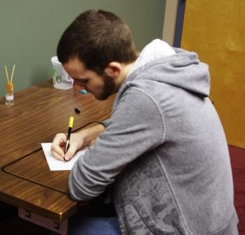
Methods: Participants
28 undergraduate students
15 participants played the story-driven version of the adventure (Strong Narrative Condition)
13 participants played the a purely objective-based version of the adventure (Weak Narrative Condition)
A few participants had to be removed from the data analysis for not following directions, etc.

Slide 7
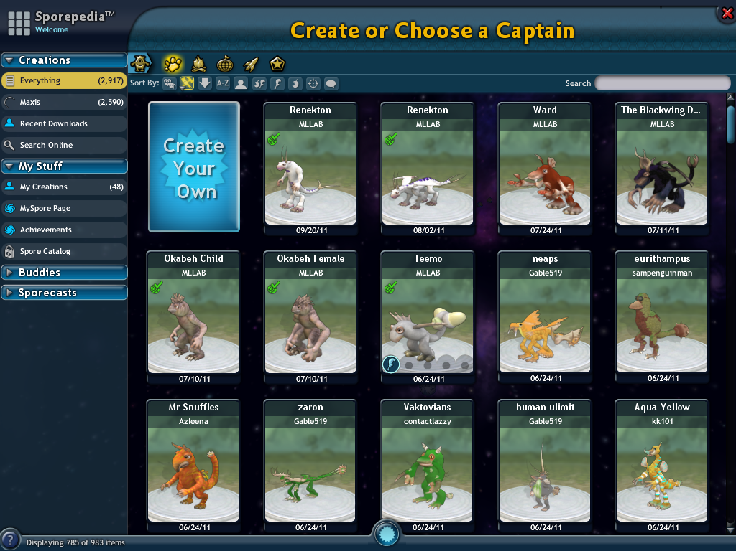
Notes:
7

Slide 8
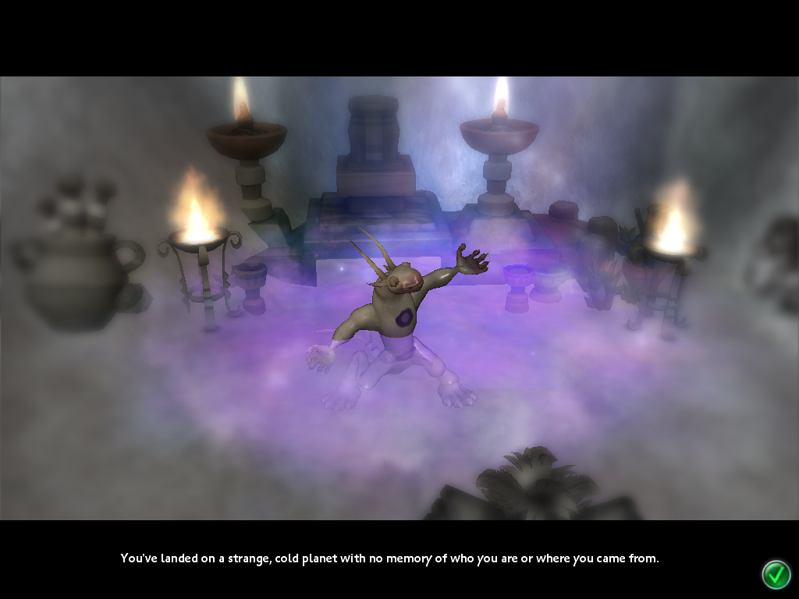
Notes:
8

Slide 9

Notes:
9

Slide 10
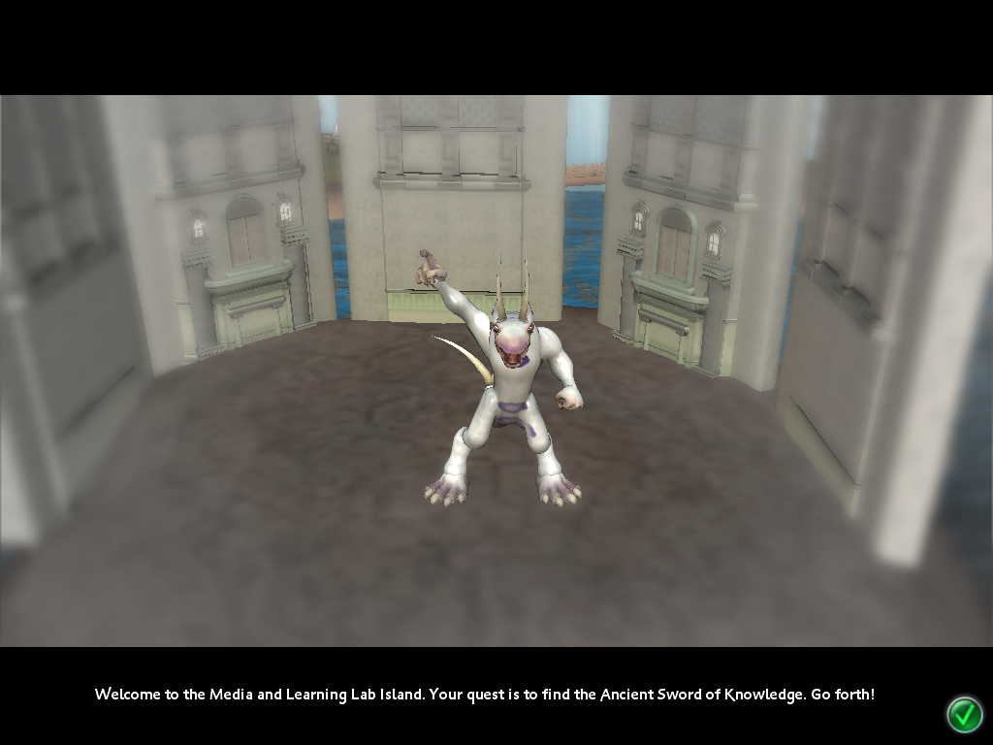
Notes:
10

Slide 11
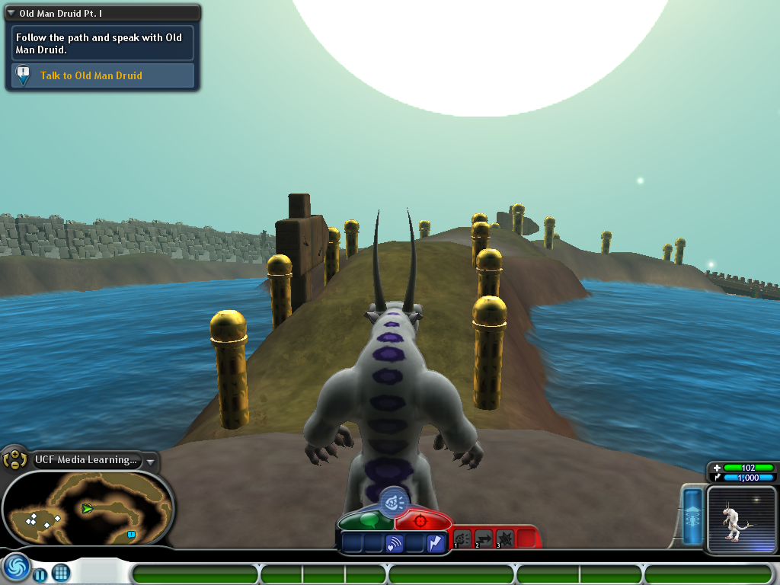
Notes:
11

Slide 12

Methods: Pre-Questionnaire
Gather background information on participants that pertain to study
Basic demographics
Previous gaming experience
Narrative-driven activities (movies, books, television, etc)

Slide 13
Post-Questionnaire
Presence and self-efficacy
questions examine player's
feelings of immersion and
competence in the environment
Questions assess learning by probing:
Recall of game events
Diagramming ability
Recall of avatar
Awareness of virtual surroundings

Slide 14
Methods: Physiological Data Collection
During the study we recorded participants’ skin conductance (arousal) for the first 10 minutes of game play
Recorded 2 min. baseline to account for individual differences

Slide 15
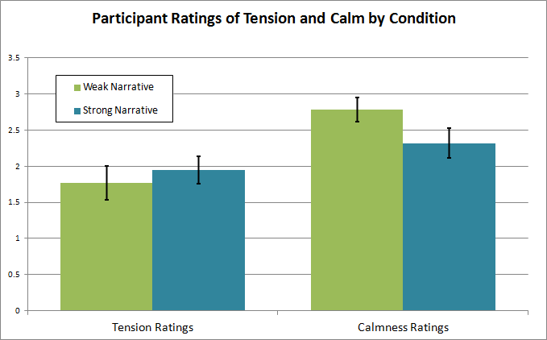
Results: Feelings of Tension vs. Feelings of Calm
Participants in the Strong Narrative condition reported having slightly more tension and feeling less calm than Weak Narrative participants.
Suggests more active engagement in the game

Slide 16
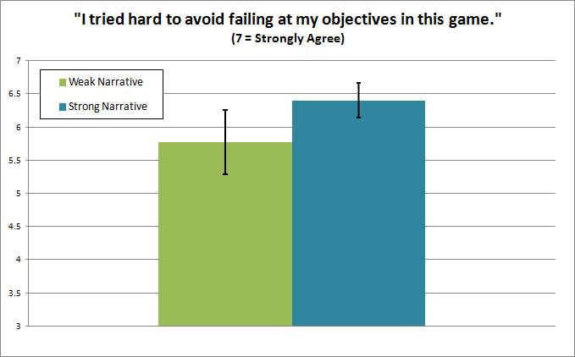
Results: Self-Efficacy
Participants in the Strong Narrative condition reported trying harder to avoid failure

Slide 17
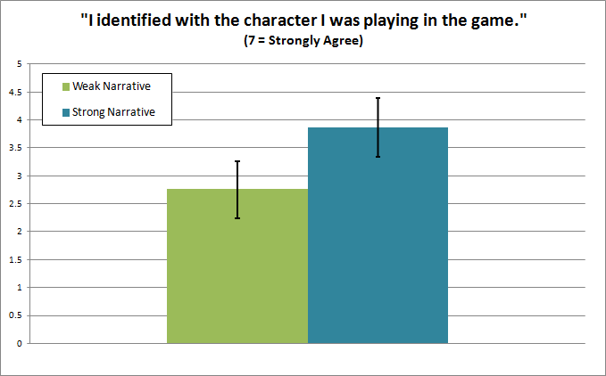
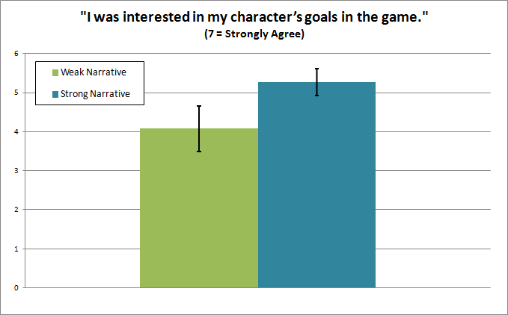
Results: Presence
Participants in the Strong Narrative condition reported greater identification and interest in their character in the game

Slide 18
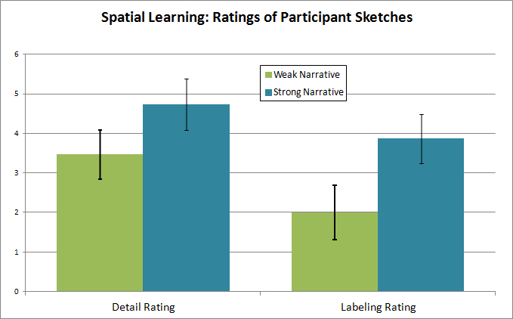
Diagram Results
Participants in the Strong Narrative condition drew sketches with more detail and made a greater effort to label the important elements in the sketch

Slide 19
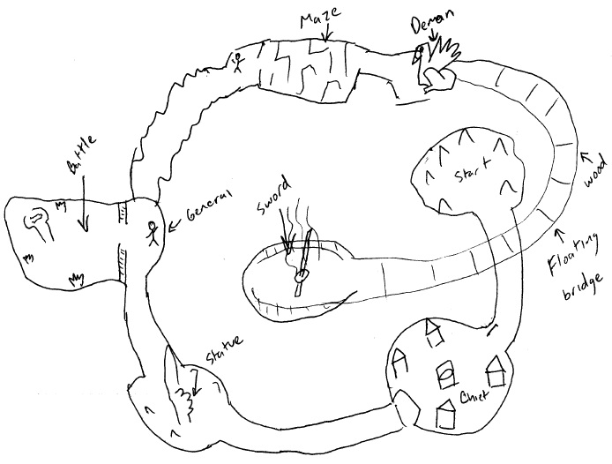
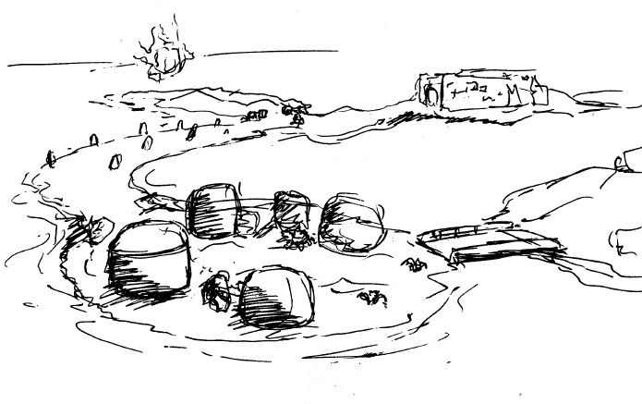
Diagram Results
Narrative

Slide 20
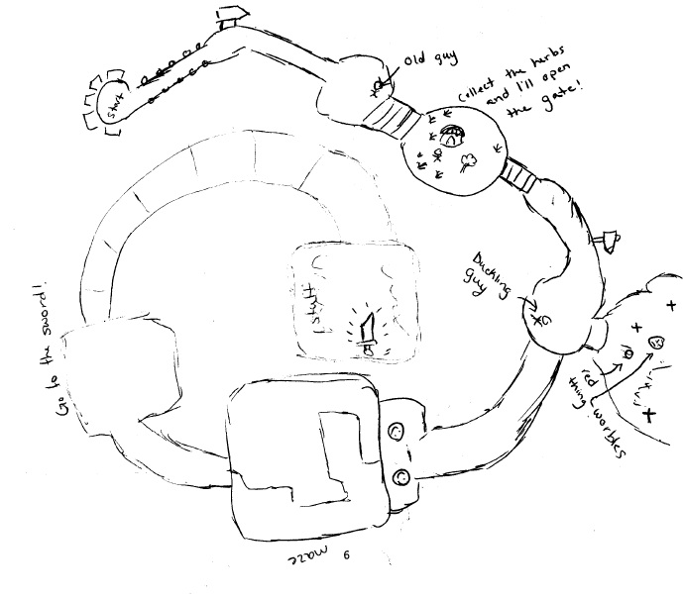
Diagram Results
Non Narrative

Slide 21
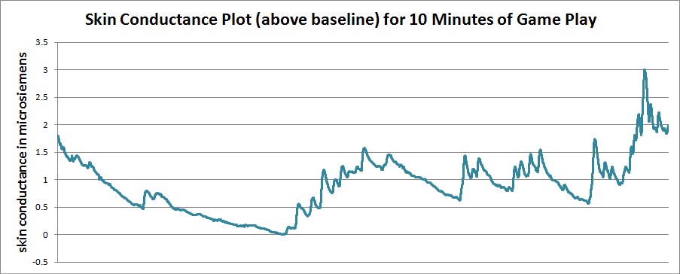
Physio Results
Skin conductance data will require more analysis, but below is a typical arousal plot for a Strong Narrative participant for 10 minutes of playing the game

Slide 22
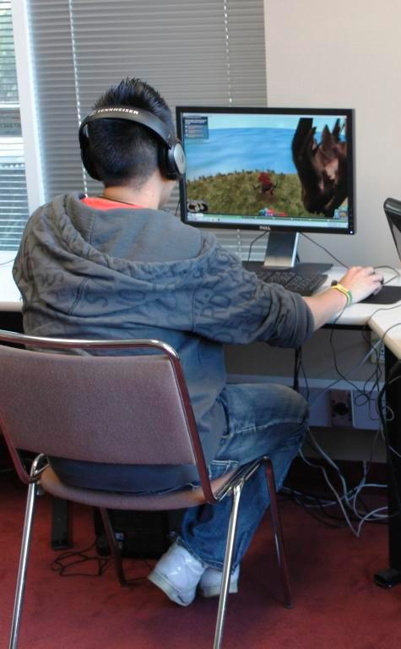
Positive Results Encourage Further Studies
Results suggest that having a strong narrative can increase feelings of immersion and help structure players’ memories of game events.

Slide 23
Thank You!
For more information on this study please contact:
Veronica Vega – vvega@knights.ucf.edu
Dr. Robb Lindgren – robb.lindgren@ucf.edu
Dr. Rudy McDaniel – rudy@ucf.edu
For more information regarding the UCF Media & Learning Lab:
http://dm.ucf.edu/~medialearninglab

